Slide 1
WBS Foundation Year and WP activities Update on activities and impact
Thanks to
Matt Chennells for his help with the data and figures
Everyone that helped find and provide data: Dave Edie & team, Paul Johnstone & team, Danni Niing, UG teams, Jo Bowers and more
Tina Kiefer
Professor of Organizational Behaviour
Assistant Dean Widening Participation
September 2022

Slide 2
Agenda:
Recent WP-related projects and strategic developments
What works and what needs more thought
Recent insights from data on WP/FY
Insights for inclusive education strategy
Conclusions
→ Feedback welcome!

Slide 3
Background
Working towards the 3 core elements of our WP strategy
Data in the report
Draws on cohorts 1-5 (Oct 2015 to Oct 2020), some from cohort 6
Merges data from 4 different sources – rarely straight forward
Partly inconsistent, with a lot of missing data

Slide 4
NOTE, distinguish between
WP Strategic Priorities:
Supporting our mission, embedded in WBS’ and Uni’s strategy
Increase diversity (best students regardless of background)
Engage and support responsibly
Raise aspirations in and beyond WBS
Measure and learn
WP Activities:
Defined by Gov and Uni as Access, Outreach & Support
Need to be aligned to strategy
Activities vary in the degree to which they directly affect WBS

Slide 5
Tina: Update on programmes, events, projects etc – established, in progress, to do…

Slide 6
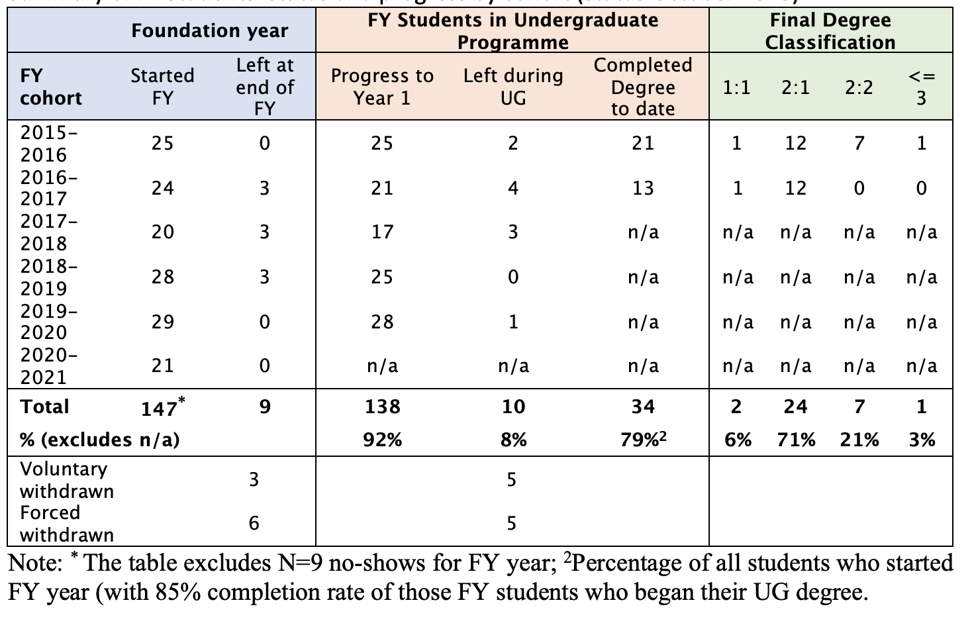
Status Quo (Oct 2020)
Cohort 7:
16 students

Slide 7
Compare FY – contextual offer – other direct entry similar to previous but just the green columns and a note on dropoout

Slide 8
Who are the FY Students? Gender and Ethnicity – add a comparison to DE
Gender | Female | Male | TOTAL
C1-C6 | 48 | 90 | 138
% | 35% | 65% | 100%
FY Year | Arab | Asian | Black | White | Chinese | Mixed | Other | Prefer not to say | Total
15/16 | 0 | 12 | 6 | 3 | 1 | 1 | 1 | 1 | 25
16/17 | 0 | 8 | 2 | 10 | 1 | 0 | 0 | 0 | 21
17/18 | 0 | 4 | 4 | 6 | 0 | 3 | 0 | 0 | 17
18/19 | 1 | 12 | 8 | 3 | 0 | 1 | 0 | 0 | 25
19/20 | 0 | 14 | 6 | 6 | 0 | 3 | 0 | 0 | 29
20/21 | 0 | 8 | 1 | 8 | 1 | 2 | 2 | 0 | 22
Total | 1 | 58 | 27 | 36 | 3 | 9 | 3 | 1 | 138
% | 0.7% | 42.0% | 19.6% | 26.1% | 2.2% | 6.5% | 2.2% | 0.7% | 100%
31.0% of black student population!

Slide 9
Who are the DE_WP Students? Similar to previous
Gender | Female | Male | TOTAL
C1-C6 | 48 | 90 | 138
% | 35% | 65% | 100%
FY Year | Arab | Asian | Black | White | Chinese | Mixed | Other | Prefer not to say | Total
15/16 | 0 | 12 | 6 | 3 | 1 | 1 | 1 | 1 | 25
16/17 | 0 | 8 | 2 | 10 | 1 | 0 | 0 | 0 | 21
17/18 | 0 | 4 | 4 | 6 | 0 | 3 | 0 | 0 | 17
18/19 | 1 | 12 | 8 | 3 | 0 | 1 | 0 | 0 | 25
19/20 | 0 | 14 | 6 | 6 | 0 | 3 | 0 | 0 | 29
20/21 | 0 | 8 | 1 | 8 | 1 | 2 | 2 | 0 | 22
Total | 1 | 58 | 27 | 36 | 3 | 9 | 3 | 1 | 138
% | 0.7% | 42.0% | 19.6% | 26.1% | 2.2% | 6.5% | 2.2% | 0.7% | 100%
31.0% of black student population!

Slide 10
Who are the FY Students? WP criteria can we have 3 rows? FY, DE_WP, DE?
AVERAGE ENTRY TARIFF about 56% lower
FY = 99 DE = 176
1. Care: 2 out of 120 FY students have been in local authority care. For DE: 2 over the same time period
2. School with lower than national average performance:
4. First in family to HE :
 | Total | SLP: yes | %
FY | 133 | 91 | 68%
DE (39% MD) | 444 | 58 | 13%
 | Total | 1st gen | %
FY | 135 | 75 | 56%
DE (29% MD) | 444 | 118 | 27%
3. School with higher than average free school meals:
5. Low Participation neighbourhood (Polar Quintile 1):
 | Total | FSM: yes | %
FY | 133 | 69 | 52%
DE (46% MD) | 444 | 11 | 2%
 | Total | FSM: yes | %
FY | 135 | 53 | 39%
DE (5% MD) | 444 | 25 | 6%
Index of Multiple Deprivation:
IMD | Total | IMD 1 | % | IMD 2 | % | IMD 3 | % | IMD 4 | % | IMD 5 | %
FY | 130 | 51 | 39% | 33 | 25% | 23 | 18% | 13 | 10% | 10 | 8%
DE (10% MD) | 444 | 49 | 11% | 50 | 11% | 64 | 14% | 82 | 18% | 153 | 34%
(DE=direct entry, MD= missing data)
Notes:
IMD considers seven dimensions: income deprivation; employment deprivation; health deprivation and disability; education; skills and training deprivation; barriers to housing and services; and living environment deprivation and crime

Slide 11
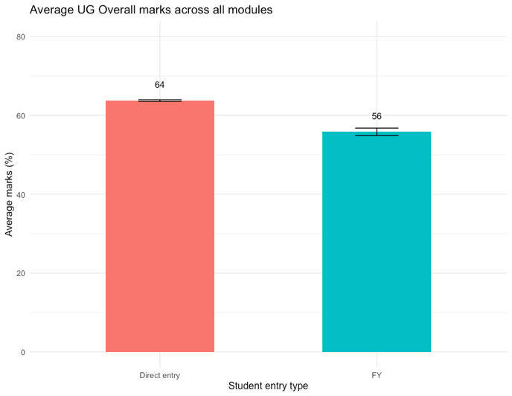
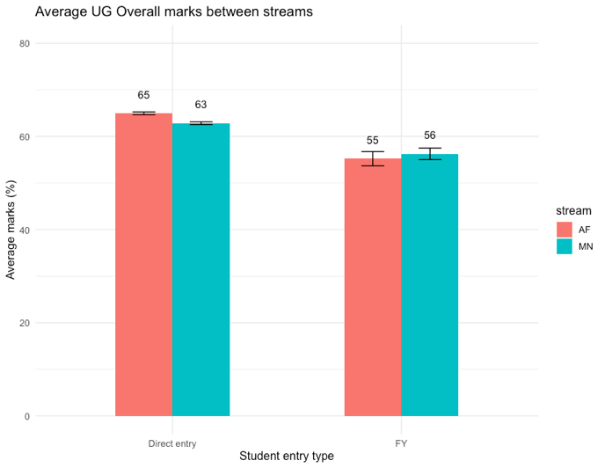
Average marks across all modules: Lower for FY 3 columns, DE, DE_WP, FY
Note: difference is stronger for numeric modules (61:48) than social-science modules (64:61)

Slide 12
Average marks across all modules: add slide with ethnicity – achievement gap, as per Sue’s request for ethnicity PLUS a clear and visible way to show FY vs Non-FY achievement gap
Note: difference is stronger for numeric modules (61:48) than social-science modules (64:61)

Slide 13
Further insights from the report - and WP_DE?
FY students attend lectures less frequently than DE students (no difference for seminars)
FY students were granted 2x more mitigating circumstances during Covid, and 3x more before compared to DE students
Multiple deprivation is associated with lower marks and higher mitigating circumstances → some of the lower marks may be explained by higher mit cirs
Tariff and FY marks predict UG marks, with FY marks having a stronger effect. But there are outliers!

Slide 14
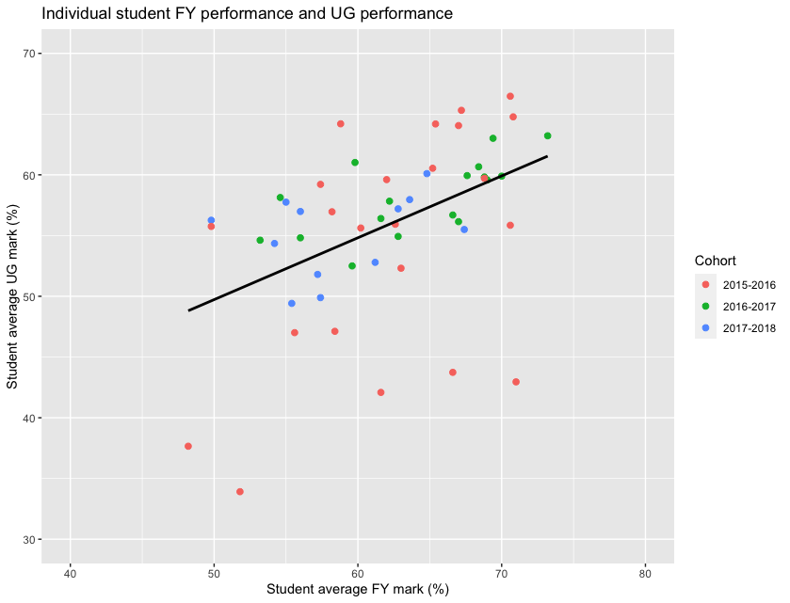
Not visible in the quant data is the continuous struggle of some of the FY students!
Selection of FY students is key

Slide 15
Conclusions, next steps etc
The FY is enhancing diversity in the school (one strategic aim) → Aiming to recruit more female and black students
Progression of FY students is very high, which is a result of our FY design and structure → Communicate better (Augar report!)
The majority of FY are successful in graduating with a good degree. 71% achieve 2:1, despite on average 56% lower tariff → Aiming to recruit more female and black students
Some students struggle and need substantial support → Improve selection? Early warning systems? Better wrap-around for students with multiple deprivation?
NO reliable data for WP students that come via Direct Entry, yet those are increasing in numbers through various programmes → Identify those students, evaluate their progress and improve support if necessary
The market for WP UG students is changing - how do we adapt and respond? → Develop a much better narrative about why students should join the FY (and then market accordingly)

Slide 16
Requested
1. Module level data for each year group broken down so that we can annually (or termly) look at:
WP (potentially looking at this against different criteria like type of school and socio economic status as well as aggregated although only if the sample size is sufficiently large to warrant this) vs non WP home students
Suggest that this needs to be three columns: FY, WP_DE, other_DE (home students)
Also one slide with WP students with and without scholarship
FY vs other home students
FY vs WP students
Black Home vs White home students (or maybe we want this by ethnic background?)
Suggest this to be our 5 categories, black, Asian, Chinese, Arab, and White to show that black is same as others.
Why just home students?
International (with the potential to look at this broken down by different countries) vs home students
International Management vs Management vs A&F vs Non-WBS students
Potentially those with learning disability vs rest if this data is available or can be inputting into our MIS.
Do we have this data?

Slide 17
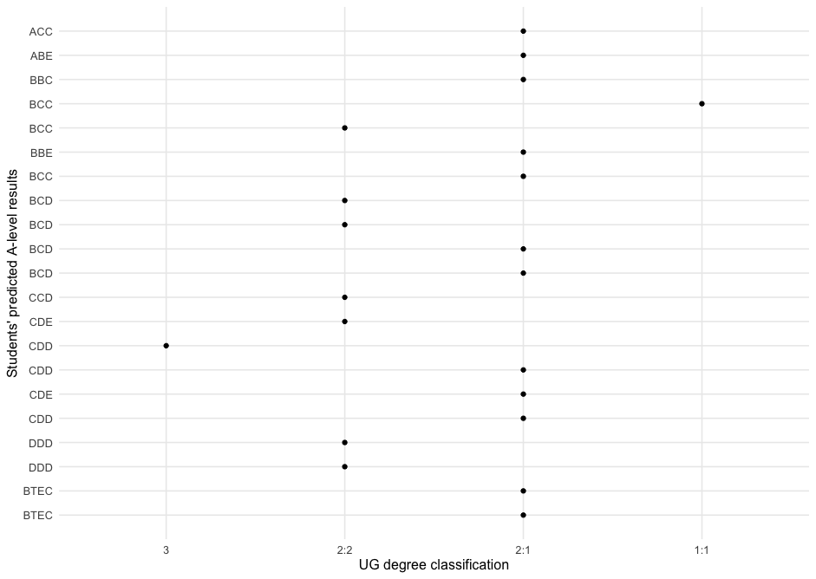
Predicted A-level vs Degree (FY Cohort 1)

